Slide 1
Facial Emotion Detection
Louis Boulas

Slide 2
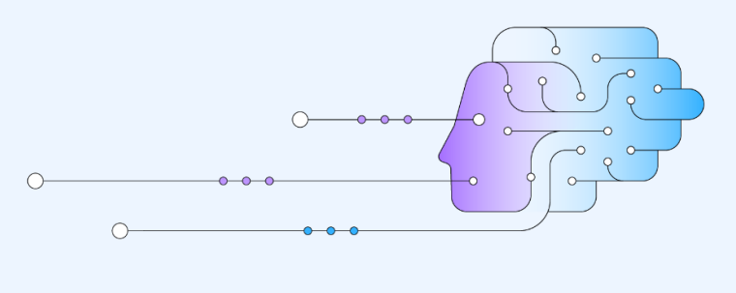
Agenda
Problem Definition
Solution Approach
Final Model Solution
Limitations and Recommendations
Business Implementation

Slide 3
Problem Definition
55% of communication takes place through visual cues
Leverage AI/ML to detect facial emotions
Build a deep neural network to classify facial expressions
Detecting Mental Disorders
Use cases
Video Game Testing
Enhancing Virtual Assistants

Slide 4
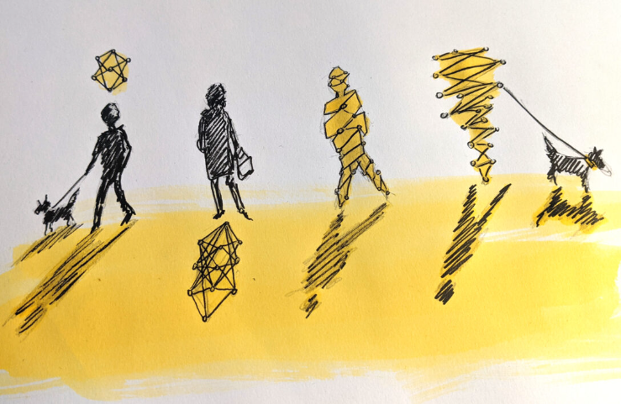
Solution Approach
CNN vs ANN
Local spatiality
Weight sharing
Transfer learning models (VGG16, ResNet V2, EfficientNet)
Color mode
Grayscale vs RGB
Model architecture
Hyperparameter tuning

Slide 5
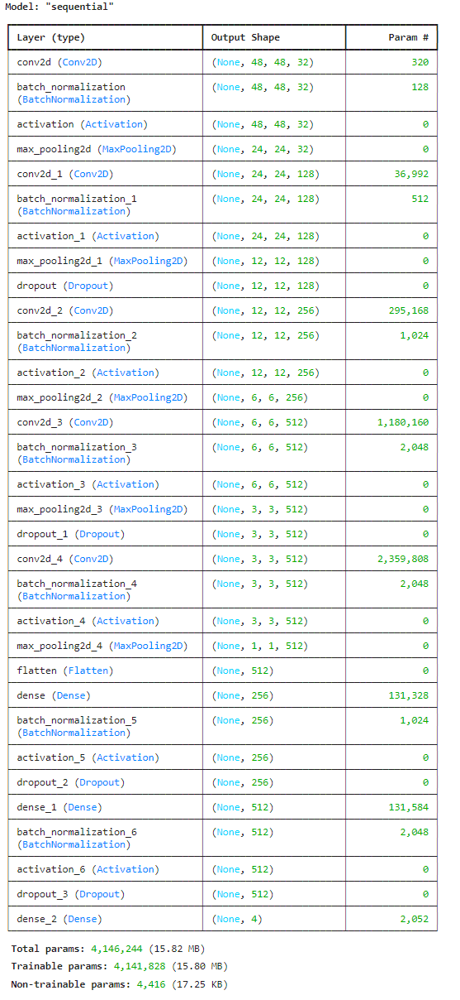
Final Model Solution
Convolutional Block
Convolutional Block
Convolutional Block
Convolutional Block
CNN
Grayscale image input
SGD optimizer
Softmax activation
4 million trainable parameters
Convolutional Block
Flatten Layer
Fully-Connected Block
Fully-Connected Block
Output Layer

Slide 6
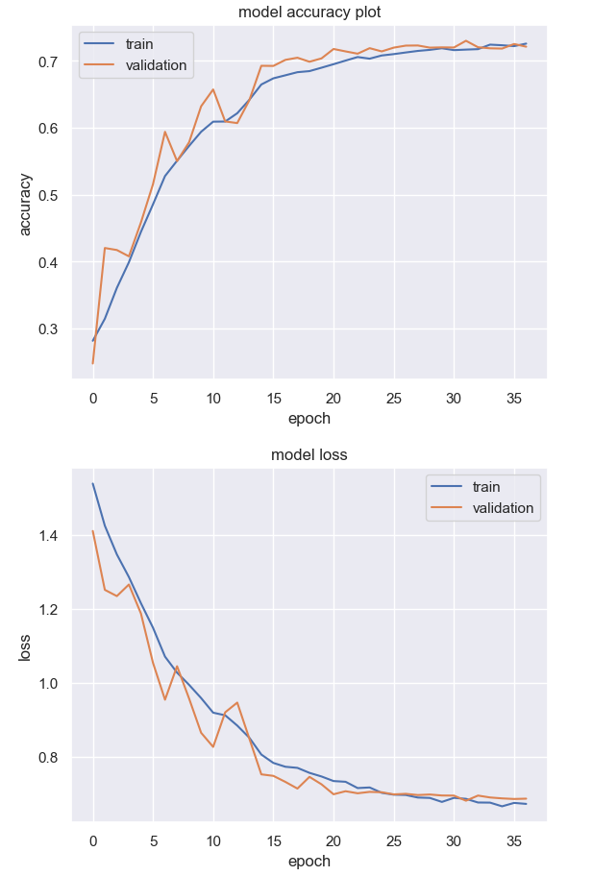
Final Model Solution
Generalized performance
Plateaued at around the 30th epoch
72% accuracy
0.68 loss
83% accuracy on the test set

Slide 7
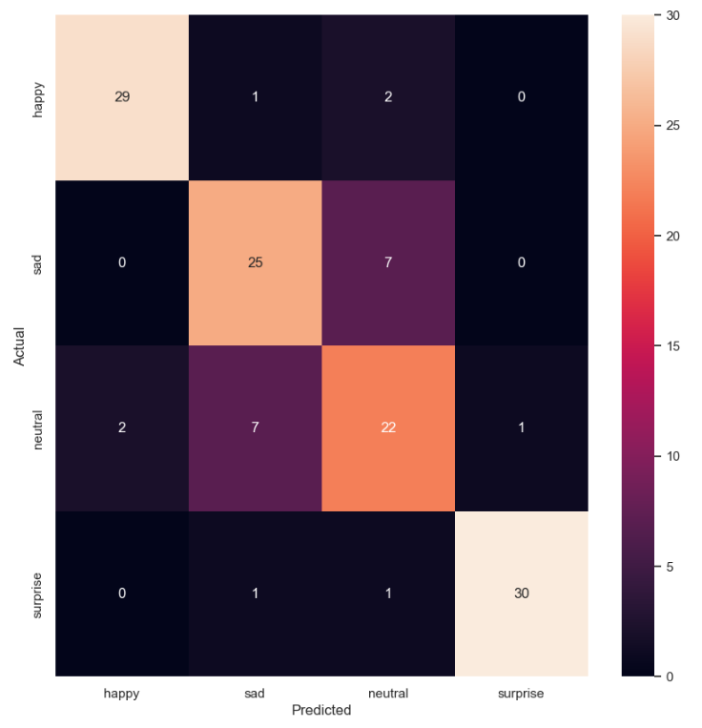
Final Model Solution
0990
Confusion Matrix

Slide 8
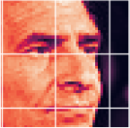
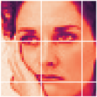
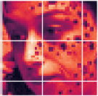
Limitations and Recommendations
Limitations
Lack of distinguishable features between the Sad and Neutral emotion classes
Imbalance in training and validation data
Sub-optimized model
Recommendations
Larger and more evenly distributed training dataset
Further hyperparameter tuning (i.e. trying different optimizers)
Data Angle
Sad
Neutral
Sad

Slide 9
Limitations and Recommendations
Limitations
Ethical and privacy concerns
User privacy
Security of data
Data misuse
Recommendations
Identify solutions to the inherent risks
User consent forms
Sensitive data handling training
Robust security system
Ethics Angle

Slide 10
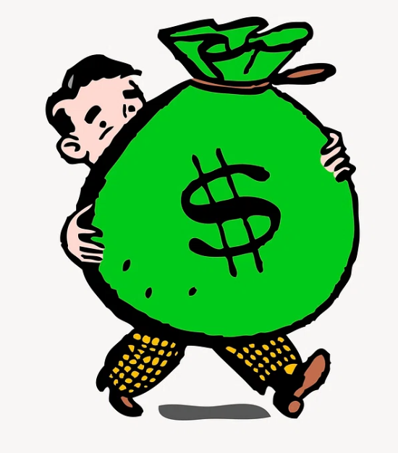
Business Implementation
Data Collection
Gathering images for training
Cloud computing software
Compute
Storage
Data transfer
Post-deployment model monitoring tools
Labor associated costs
Training and Deploying a Deep Learning Model

Slide 11
Thank You!

Slide 12
Appendix

Slide 13
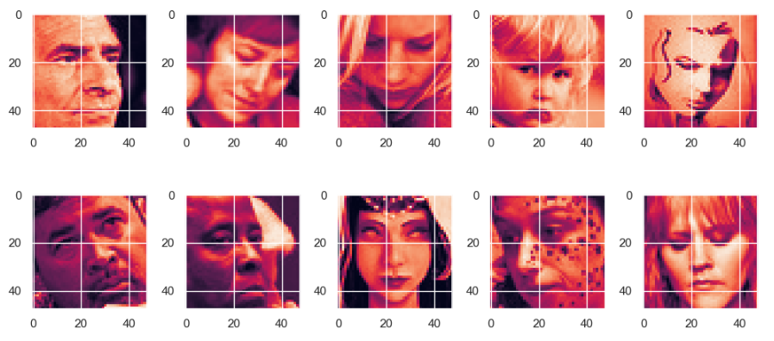
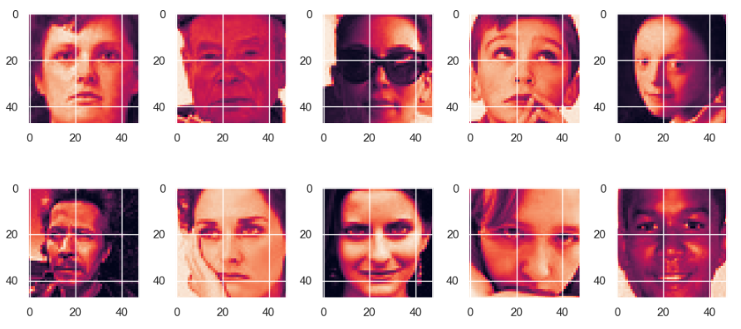
Sad
Neutral

Slide 14
Model Comparisons
CNN Model # | Train Acc | Train Loss | Val Acc | Val Loss | Test Acc | Test Loss | Notes | Epochs
Gray 1 Base | 77.5% | 0.67 | 68.1% | 0.81 | 68% | 0.83 | lr = 0.01 | 24
Gray 2 Base | 65.5% | 0.84 | 64% | 0.91 | 60.2% | 0.96 | lr = 0.001 | 41
Gray 3 | 77.7% | 0.54 | 71.3% | 0.73 | 73.4% | 0.69 | Larger, lr = 0.01 | 17
RGB 1 Base | 63.5% | 0.87 | 64.4% | 0.86 | 64.1% | 0.8 | Gray 2 | 40
RGB 2 | 71.1% | 0.69 | 72.2% | 0.69 | 76.6% | 0.58 | Gray 3 | 45
VGG16 | 43.5% | 1.22 | 44.7% | 1.21 | 43.8% | 1.22 | Transfer Learning | 13
Gray 4 | 66.6% | 0.8 | 68.3% | 0.73 | 68% | 0.76 | Complex, lr = 0.01 | 40
Gray 5 | 71.8% | 0.7 | 71.3% | 0.7 | 71.9% | 0.62 | Kernel size | 42
Gray 6 | 68.3% | 0.76 | 70.8% | 0.71 | 74.2% | 0.6 | lr = 0.001 | 36
Gray 7 | 72.1% | 0.68 | 73% | 0.68 | 82.8% | 0.55 | lr = 0.005, decrease: filters + dropout layers values | 32

Slide 15
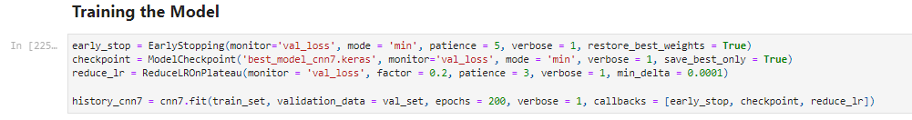
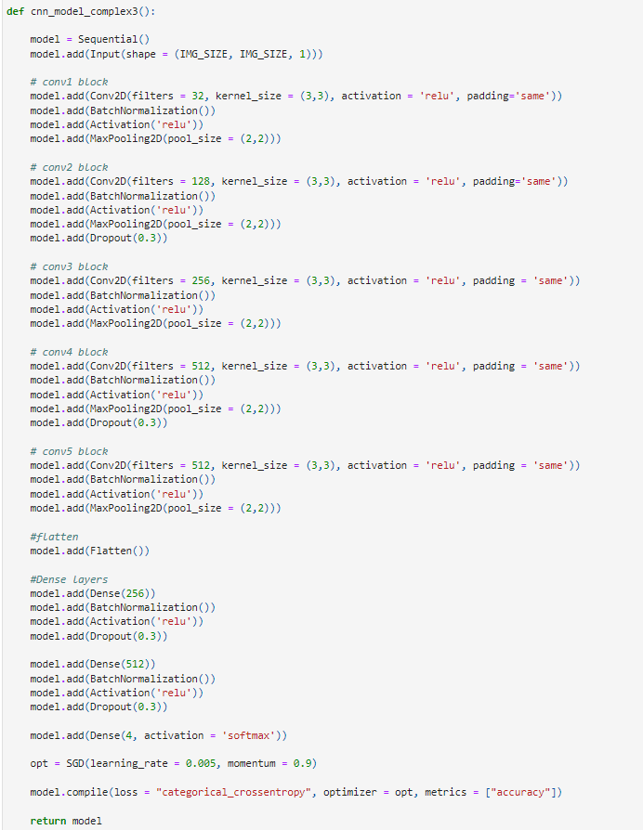
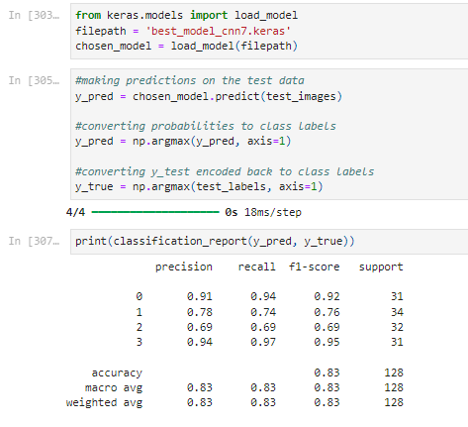
Code Snippets (Chosen CNN)

Slide 16
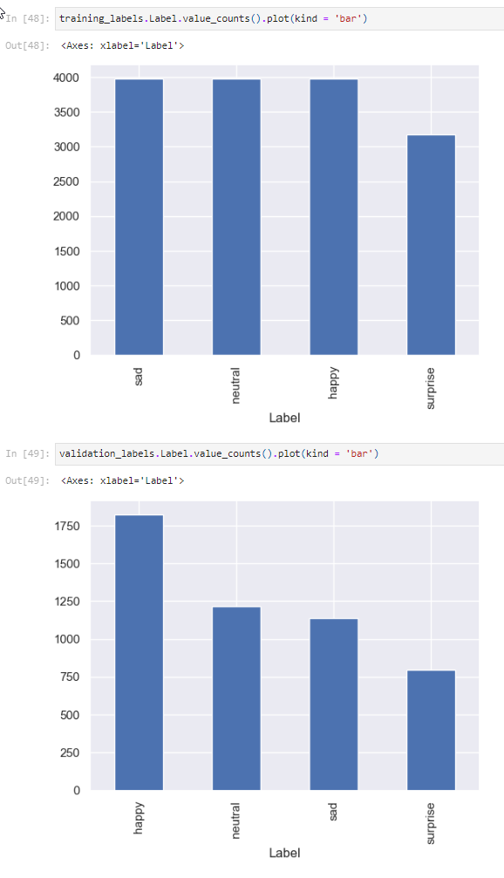
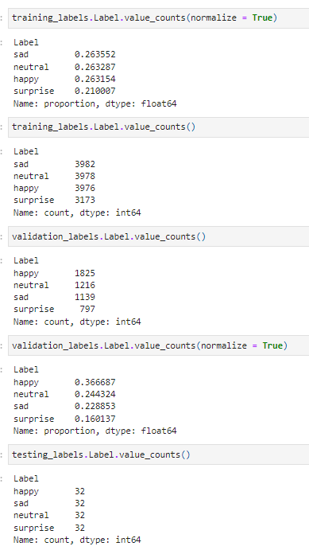
Data Distribution

Slide 17
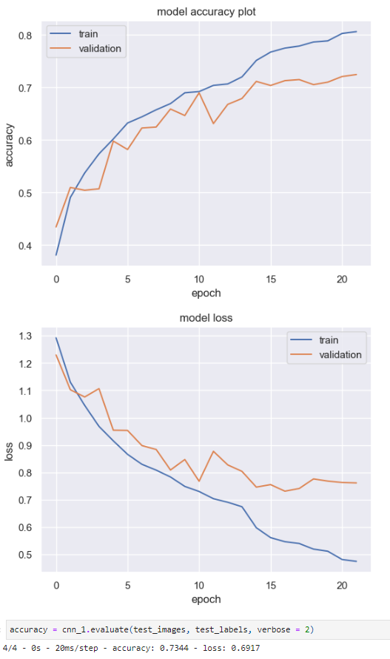
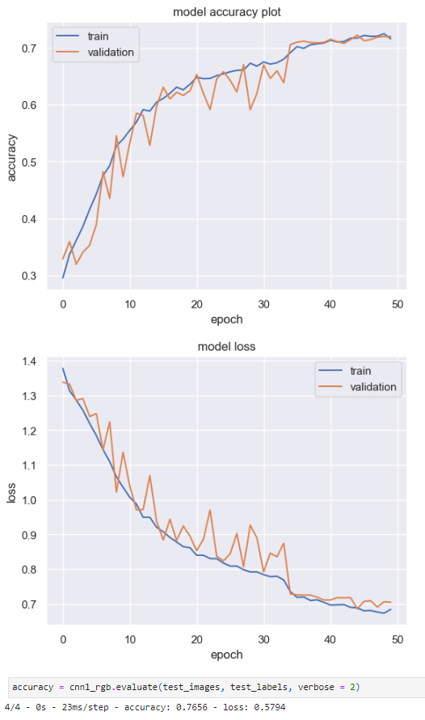
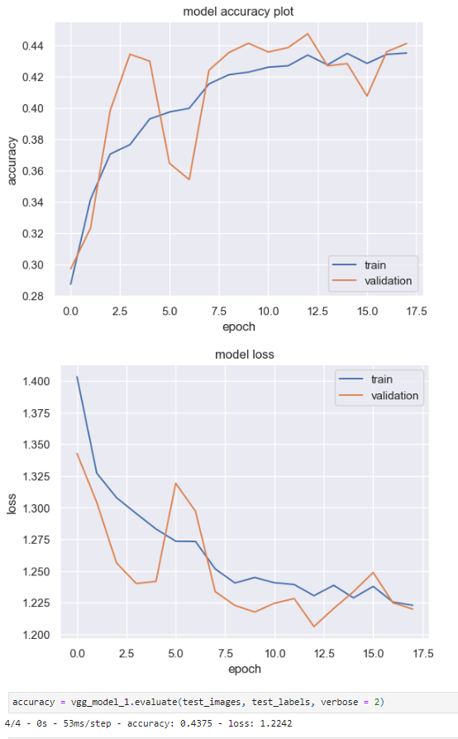
Gray 3
RGB 2
VGG16

Slide 18
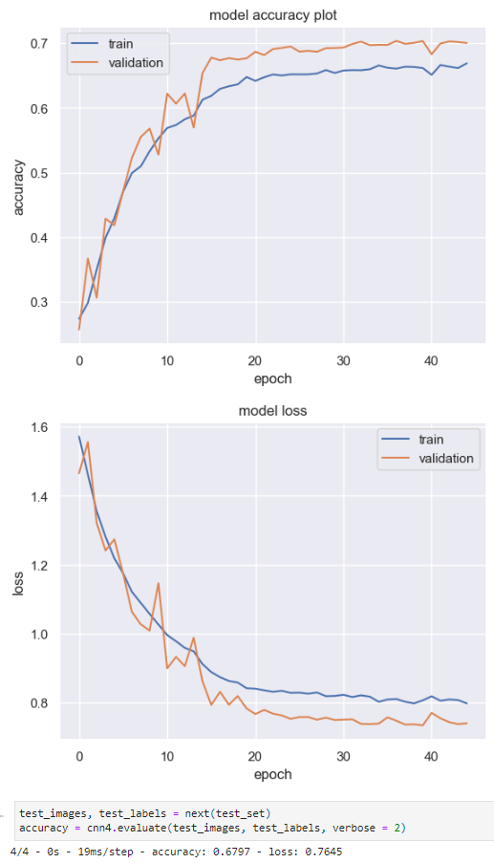
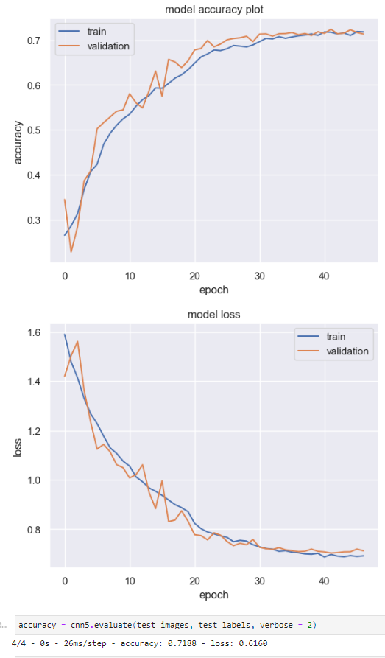
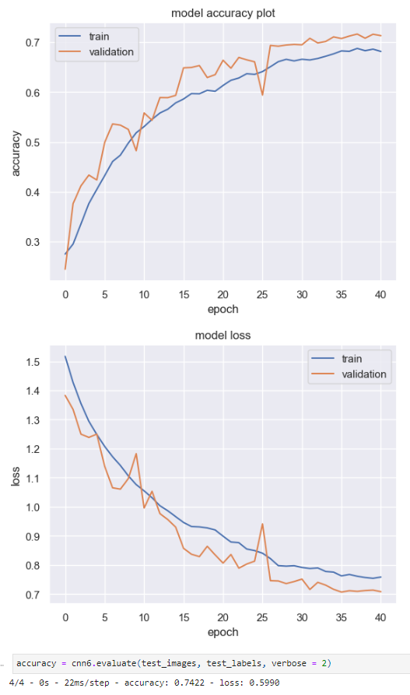
Gray 4
Gray 5
Gray 6

